Slide 1
zero

Slide 2
one

Slide 3
two

Slide 4
three

Slide 5
four

Slide 6
five

Slide 7
six

Slide 8
seven

Slide 9
eight

Slide 10
nine

Slide 11
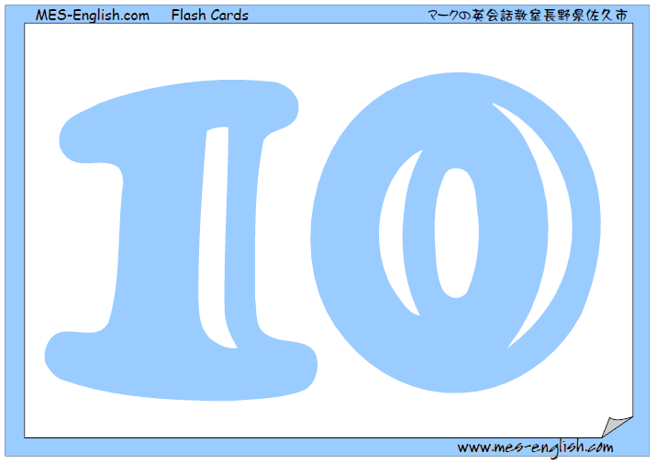
ten

Slide 12
eleven

Slide 13
twelve

Slide 14
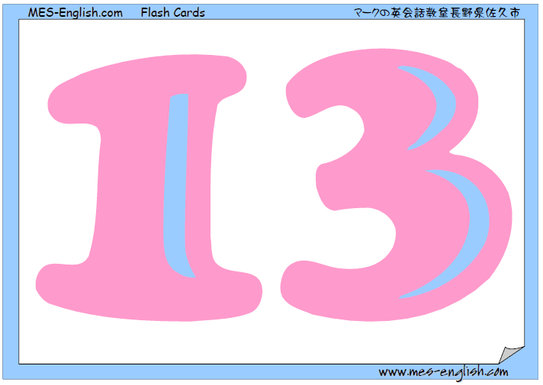
thirteen

Slide 15
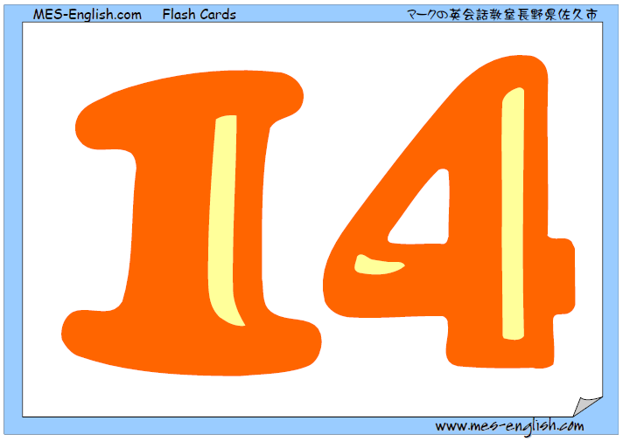
fourteen

Slide 16
fifteen

Slide 17
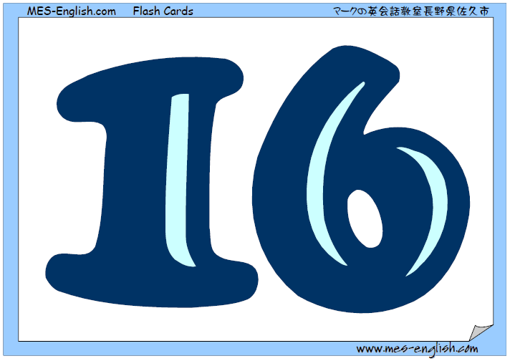
sixteen

Slide 18
seventeen

Slide 19
eighteen

Slide 20
nineteen

Slide 21
twenty

Slide 22
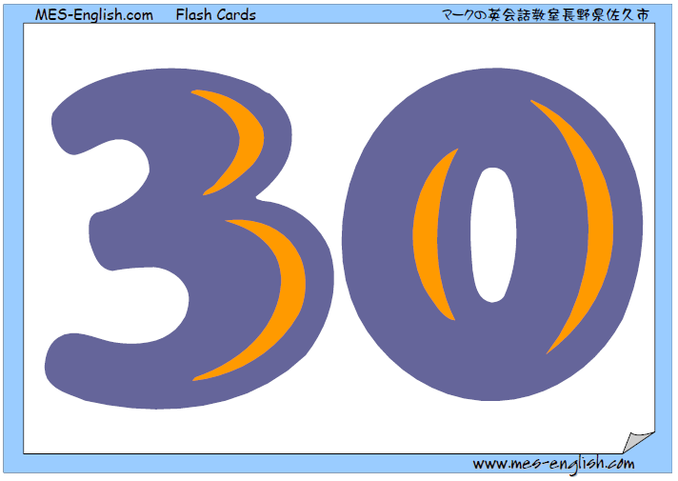
thirty

Slide 23
forty

Slide 24
fifty

Slide 25
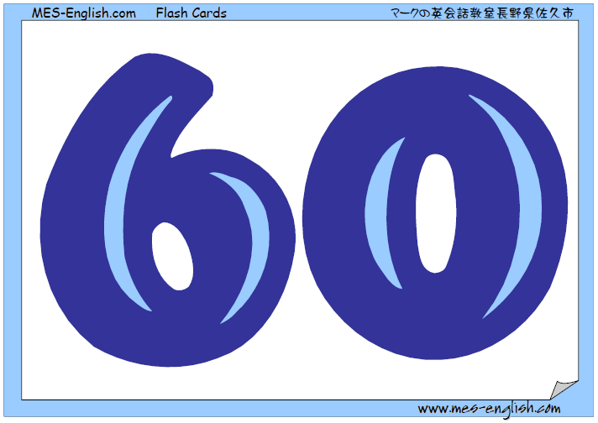
sixty

Slide 26
seventy

Slide 27
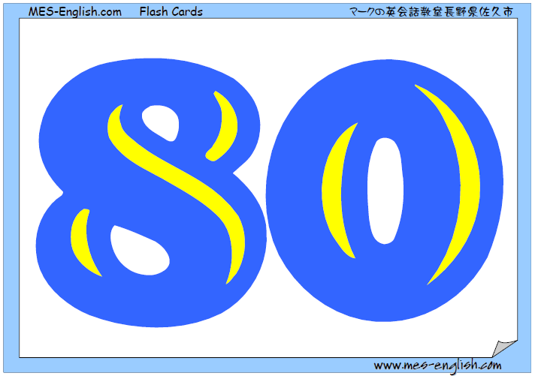
eighty

Slide 28
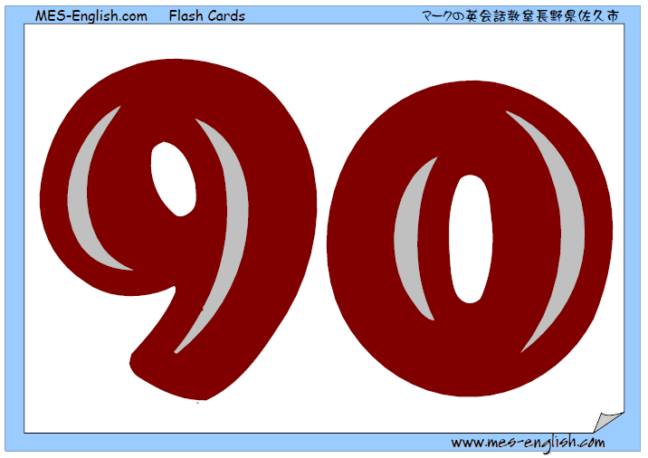
ninety

Slide 29
one hundred

